Slide 1


AI in Product Management

Slide 2
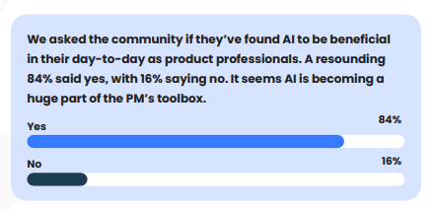

Slide 3

AI Product Management
AI product managers are the ultimate collaborators with cross-functional teams of data scientists, engineers, designers, and marketers.
They craft AI products that meet customer expectations and align with the organization’s broader objectives.

Slide 4
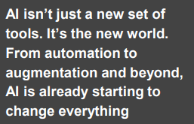
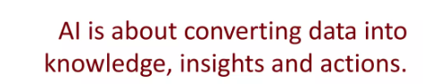


Slide 5
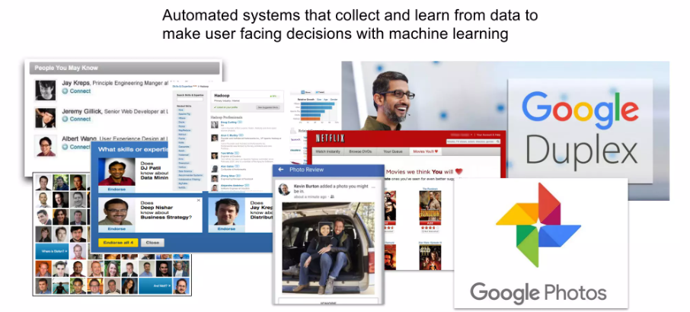

Slide 6
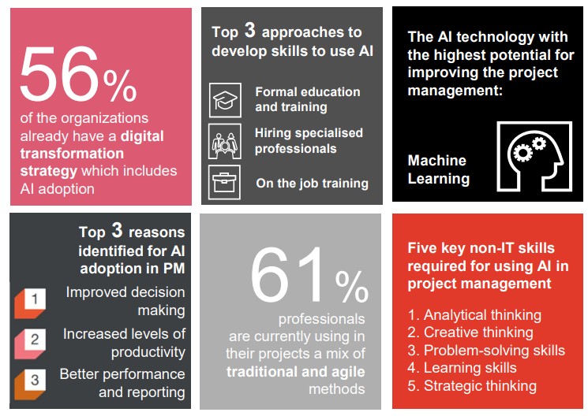


Slide 7
Levels of AI
Level 1:Manual Process
Level 2: Human intervention with AI assistance
Level 3:AI Driven with Fine tuning
Level 4:Fully Automated by AI

Slide 8
Understanding AI In PM

Slide 9
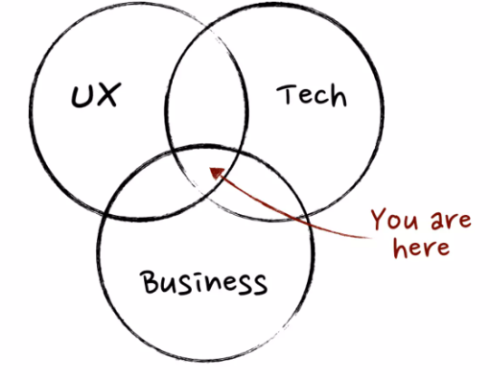

Slide 10
How to use AI in Product World

Slide 11
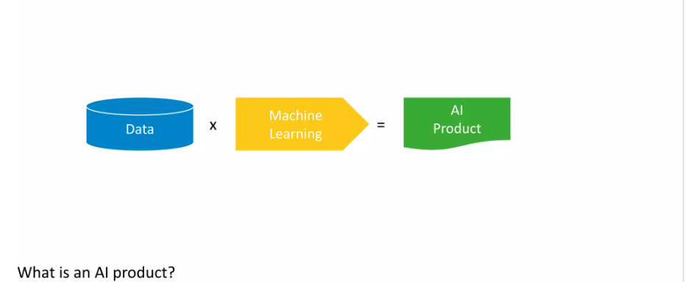

Slide 12
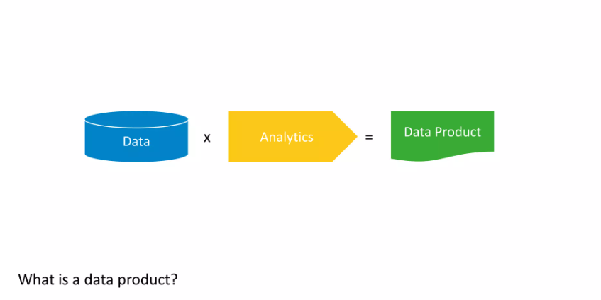

Slide 13
Making AI work

Slide 14
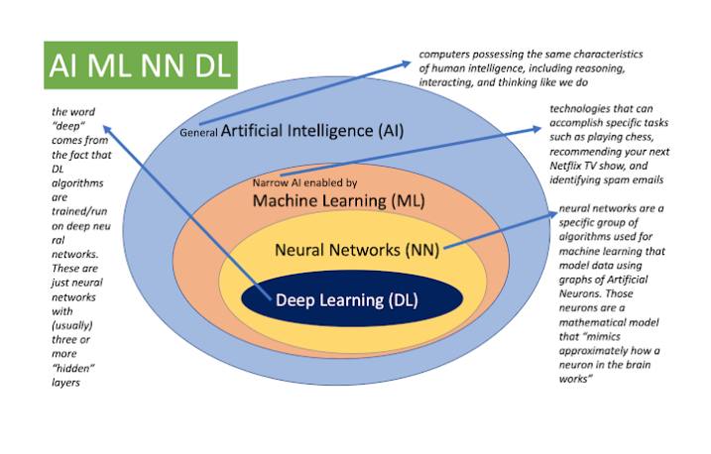

Slide 15
Data?

Slide 16
Types of Analytics

Slide 17
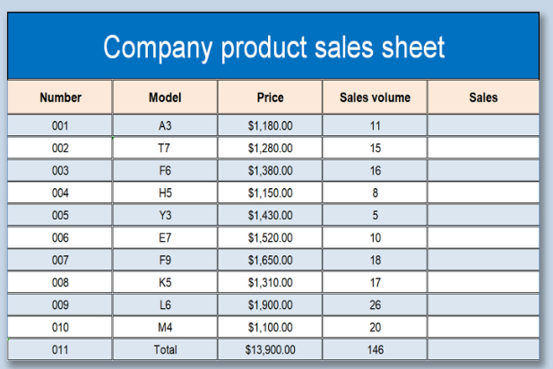
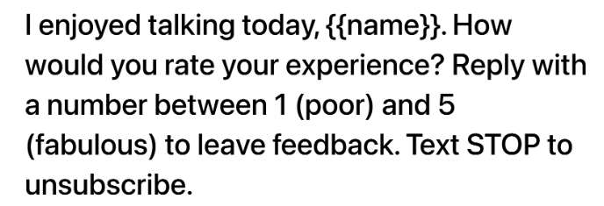

Slide 18
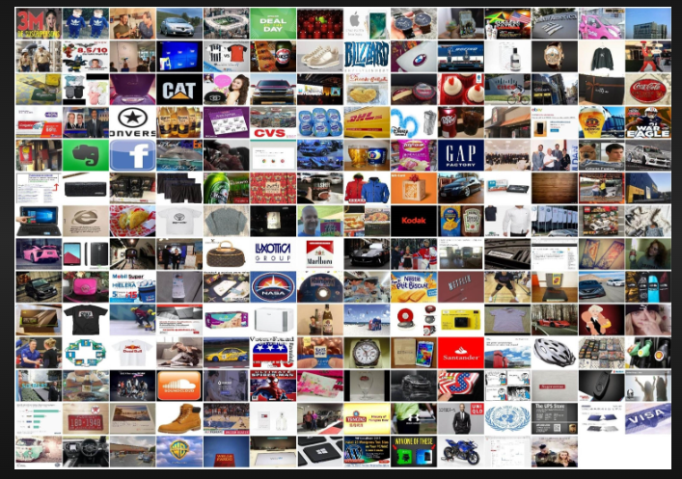
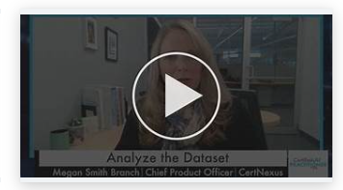
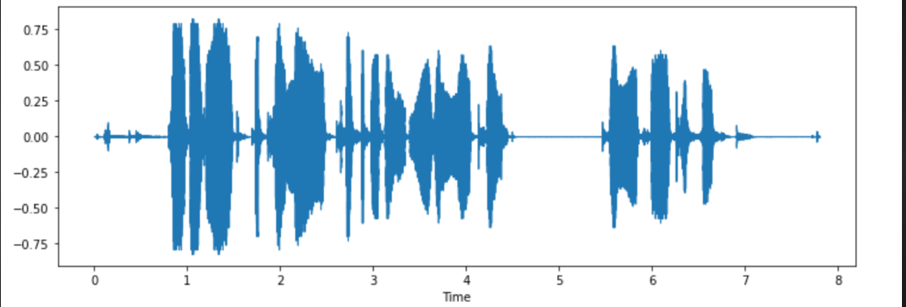

Slide 19






Slide 20
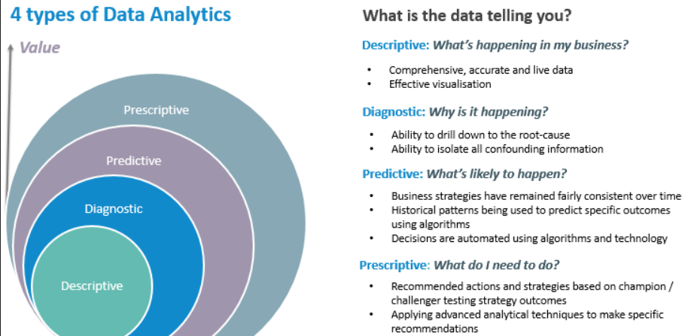

Slide 21
Scenario
TechTrendz is a leading retailer specializing in electronics and gadgets. Over the years, the company has accumulated vast amounts of data related to sales, customer behavior, inventory, and marketing campaigns. Let's follow TechTrendz through their analytics journey.

Slide 22
Analytics?
TechTrendz's analytics team starts by analyzing sales data from the previous year.
They create reports and dashboards to visualize key performance indicators (KPIs) such as total revenue, sales by product category, and geographical sales distribution.
Through descriptive analytics, they gain insights into which products are top sellers, peak sales periods, and popular customer demographics.

Slide 23
Analytics?
After identifying a decline in sales for a particular product line, TechTrendz's analysts dive deeper into the data.
They perform root cause analysis to understand the factors contributing to the decline.
Through diagnostic analytics, they uncover issues such as pricing competitiveness, insufficient marketing efforts, or changes in consumer preferences, enabling them to formulate corrective actions.

Slide 24
Analytics?
Armed with insights from descriptive and diagnostic analytics, TechTrendz's team leverages predictive analytics to forecast sales for the upcoming quarter.
By analyzing historical sales trends, seasonality, economic indicators, and market trends, they develop predictive models to anticipate demand for various products.
These forecasts help the company optimize inventory management, pricing strategies, and resource allocation.

Slide 25
Analytics?
With predictive models in place, TechTrendz's executives turn to prescriptive analytics to determine the best course of action.
Using optimization algorithms, they simulate different scenarios to maximize profitability, minimize costs, or optimize marketing ROI.
For example, they may use prescriptive analytics to decide on promotional strategies, inventory replenishment schedules, or pricing adjustments, ultimately driving business growth and competitiveness.

Slide 26
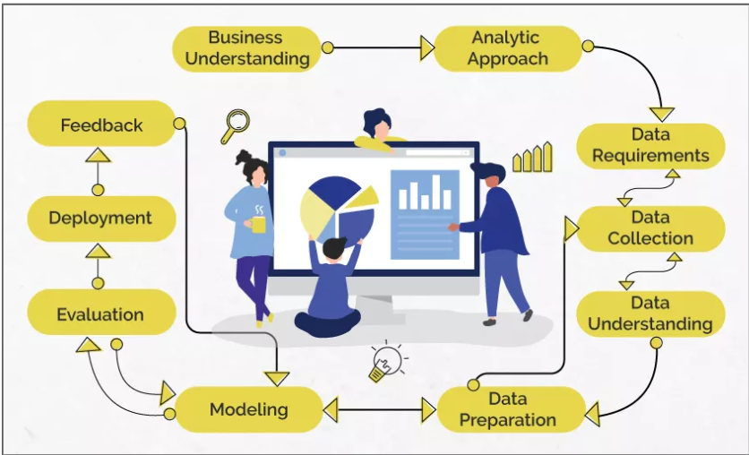
Data Science/Machine Learning

